Slide 1
Guide to Computer Forensics and Investigations Sixth Edition Chapter 1
Understanding The Digital Forensics Profession and Investigations

Slide 2
Objectives
Describe the field of digital forensics
Explain how to prepare computer investigations and summarize the difference between public-sector and private-sector investigations
Explain the importance of maintaining professional conduct
Describe how to prepare a digital forensics investigation by taking a systematic approach
Describe procedures for private-sector digital investigations
Explain requirements for data recovery workstations and software
Summarize how to conduct an investigation, including critiquing a case

Slide 3
An Overview of Digital Forensics

Slide 4
An Overview of Digital Forensics (1 of 3)
Digital forensics
The application of computer science and investigative procedures for a legal purpose involving the analysis of digital evidence after
proper search authority,
chain of custody (Evidence Transmittal Letter)
validation with mathematics (hash function),
use of validated tools,
repeatability,
reporting, and
possible expert presentation.
In October 2012, an ISO standard for digital forensics was ratified - ISO 27037
Information technology
Security techniques
Guidelines for identification, collection and preservation of evidence

Slide 5


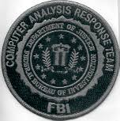
An Overview of Digital Forensics (2 of 3)
Efforts to ensure consistency in federal proceedings
The Federal Rules of Evidence (FRE)
Created Signed into law in 1973
Many states’ rules map to the FRE
FBI Computer Analysis and Response Team (CART) was formed in 1984 to handle cases involving digital evidence
By late 1990s, CART teamed up with Department of Defense Computer Forensics Laboratory (DCFL)

Slide 6
An Overview of Digital Forensics (3 of 3)
Files are maintained on a computer are covered by different rules
The Fourth Amendment to the U.S. Constitution protects everyone’s right to be secure from search and seizure
Continuing development of the jurisprudence of the amendment has established a different precedent
Separate search warrants might not be necessary for digital evidence
Every U.S. jurisdiction has case law related to the admissibility of evidence recovered from computers and other digital devices
Many investigators will include the suspect’s computer device in the search warrant

Slide 7
Digital Forensics and Other Related Disciplines (1 of 3)
NIST definition of Digital Forensics
The application of science to identification, collection, examination, and analysis of data while preserving the integrity of the information and maintaining a strict chain of custody of the data
Investigating digital devices includes:
Collecting data securely
Examining suspect data to determine details such as origin and content
Presenting digital information to courts
Applying laws to digital device practices
Digital forensics is different from data recovery
DF ensure recovered data is valid for evidence
Often don’t know whether digital devices contain evidence
Forensics investigators often work as part of a team, known as the investigations triad

Slide 8
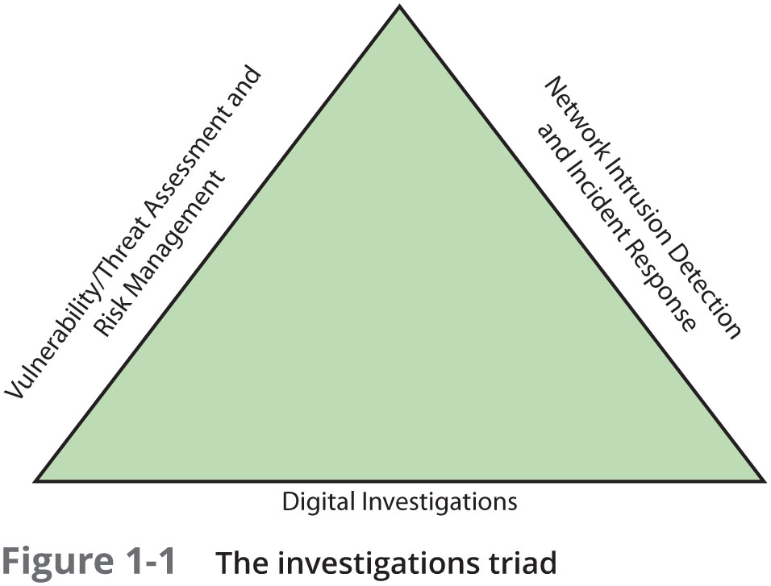
Digital Forensics and Other Related Disciplines (2 of 3)

Slide 9
Digital Forensics and Other Related Disciplines (3 of 3)
Vulnerability/threat assessment and risk management
Tests and verifies the integrity of stand-along workstations and network servers
Network intrusion detection and incident response
Detects intruder attacks by using automated tools and monitoring network firewall logs
Digital investigations
Manages investigations and conducts forensics analysis of systems suspected of containing evidence

Slide 10
A Brief History of Digital Forensics
One half-cent crime
By the early 1990s, the International Association of Computer Investigative Specialists (IACIS) introduced training on software for digital forensics
IRS created search-warrant programs without GUI
ASR Data created Expert Witness for Macintosh with GUI
Encase: ASR partner
Other tool
ILook is currently maintained by the IRS Criminal Investigation Division
AccessData Forensic Toolkit (FTK) is a popular commercial product

Slide 11
Understanding Case Law
Existing laws can’t keep up with the rate of technological change
When statutes don’t exist, case law is used
Allows legal counsel to apply previous similar cases to current one in an effort to address ambiguity in laws
Examiners must be familiar with recent court rulings on search and seizure in the electronic environment

Slide 12
Developing Digital Forensics Resources
To supplement your knowledge:
Familiar with more than one computing platform
Linux, Windows, Mac
Difference version of platform
Develop and maintain contact with computing, network, and investigative professionals
Join computer user groups in both the pubic and private sectors
Example: Computer Technology Investigators Network (CTIN) meets to discuss problems with digital forensics examiners encounter
Consult outside experts

Slide 13
Digital Investigation Types

Slide 14
Digital Investigation Types (1 of 3)
Digital investigations fall into two categories:
Public-sector investigations
Private-sector investigations

Slide 15
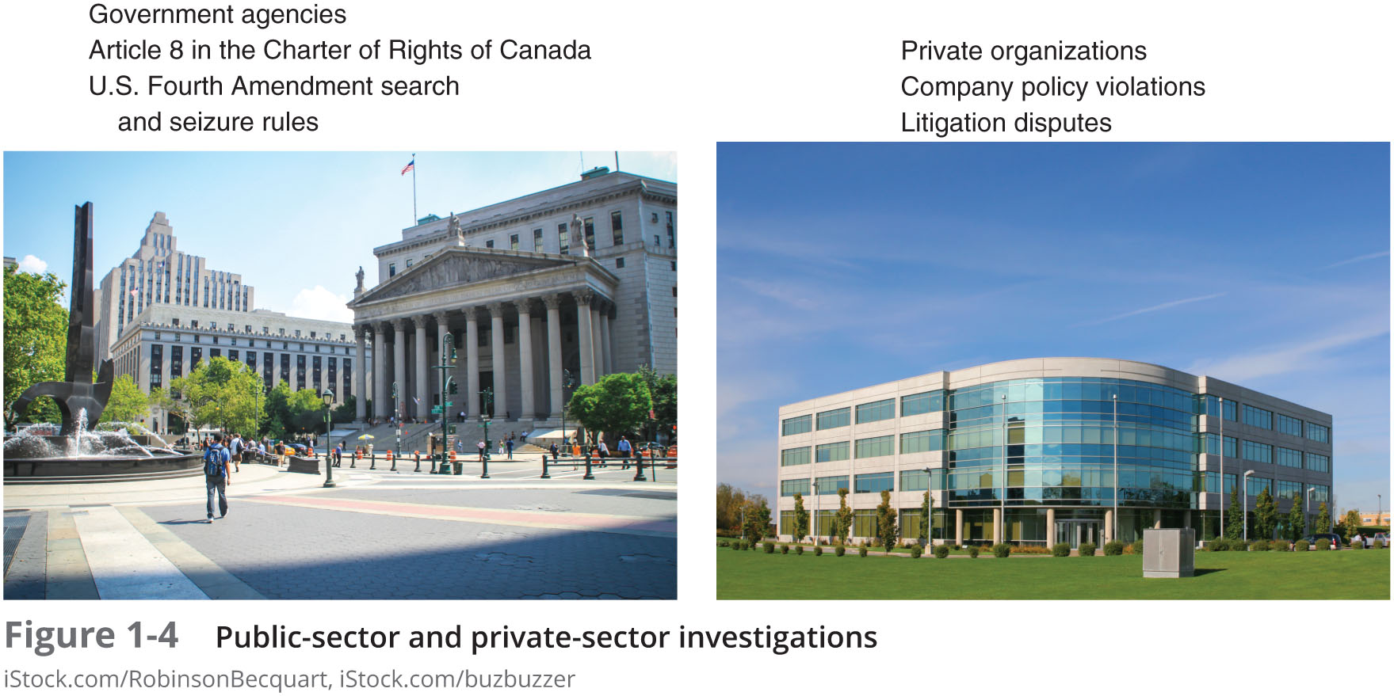
Digital Investigation Types (2 of 3)
Notes:
Government agencies responsible for criminal investigations and prosecution

Slide 16
Digital Investigation Types (3 of 3)
Public-sector investigations involve government agencies responsible for criminal investigations and prosecution
Private-sector investigations focus more on policy violations

Slide 17
Understanding Law Enforcement Agency Investigations (Public-sector)
When conducting public-sector investigations, you must understand laws on computer-related crimes including:
Standard legal processes
Guidelines on search and seizure
How to build a criminal case
Considering
Fourth Amendment to the U.S. Constitution
Restrict government search and seizure
The Department of Justice (DOJ) updates information on computer search and seizure regularly
Notes:
The right of the people to be secure in their persons, houses, papers, and effects, against unreasonable searches and seizures, shall not be violated, and no Warrants shall issue, but upon probable cause, supported by Oath or affirmation, and particularly describing the place to be searched, and the persons or things to be seized.

Slide 18
Following Legal Processes (1 of 2)
A criminal investigation usually begins when someone finds evidence of or witnesses a crime
Witness or victim makes an allegation to the police
Police interview the complainant and writes a report about the crime
Report is processed and management decides to start an investigation or log the information in a police blotter
Blotter is a historical database of previous crimes

Slide 19
Following Legal Processes (2 of 2)
Category of officers
Digital Evidence First Responder (DEFR)
Arrives on an incident scene, assesses the situation, and takes precautions to acquire and preserve evidence
Digital Evidence Specialist (DES)
Has the skill to analyze the data and determine when another specialist should be called in to assist
If sufficient cause to support a search warrant, submit
Affidavit - a sworn statement of support of facts about or evidence of a crime
Must include exhibits(evidence) that support the allegation

Slide 20
Understanding Private-Sector Investigations (1 of 8)
Private-sector investigations involve private companies and lawyers who address company policy violations and litigation disputes
Example: wrongful termination
Businesses strive to minimize or eliminate litigation
Private-sector crimes can involve:
E-mail harassment, falsification of data, gender and age discrimination, embezzlement, sabotage, and industrial espionage

Slide 21
Understanding Private-Sector Investigations (2 of 8)
Businesses can reduce the risk of litigation by publishing and maintaining policies that employees find easy to read and follow
Most important policies define rules for using the company’s computers and networks
Known as an “Acceptable use policy”

Slide 22
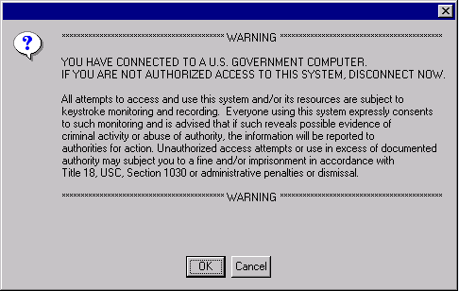
Understanding Private-Sector Investigations (3 of 8)
Business can also avoid litigation by displaying a warning banner on computer screens
Informs end users that the organization reserves the right to inspect computer systems and network traffic at will

Slide 23
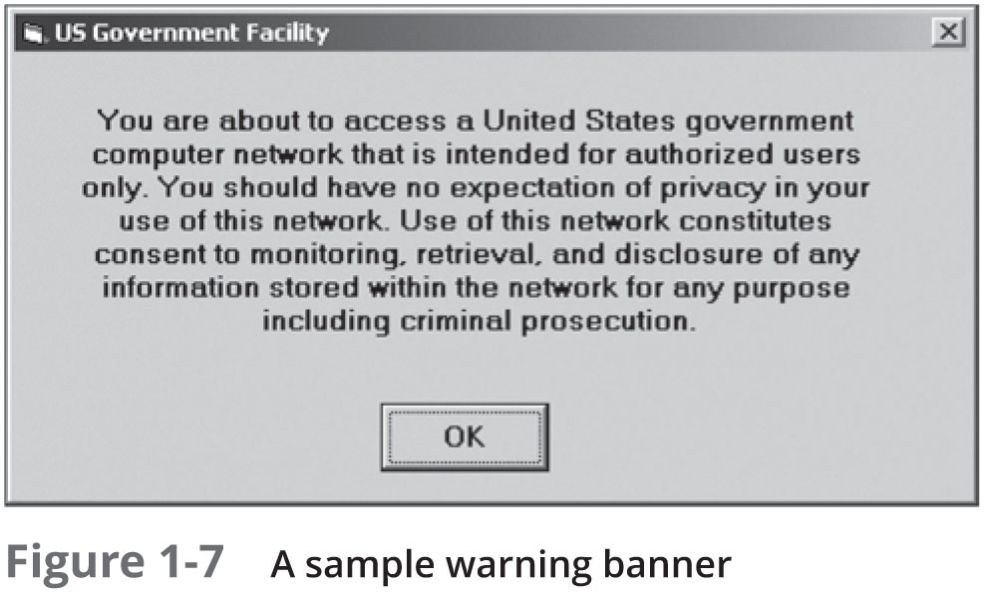
Understanding Private-Sector Investigations (4 of 8)

Slide 24
Understanding Private-Sector Investigations (5 of 8)
Sample text that can be used in internal warning banners:
Use of this system and network is for official business only
Systems and networks are subject to monitoring at any time by the owner
Using this system implies consent to monitoring by the owner
Unauthorized or illegal users of this system or network will be subject to discipline or prosecution

Slide 25
Understanding Private-Sector Investigations (6 of 8)
Business also defines Line of authority
states who has the legal right to initiate an investigation, who can take possession of evidence, and who can have access to evidence
Examples of groups with authority
Corporate security investigations
Corporate ethics office
Corporate equal employment opportunity office
Internal auditing
The general counsel or legal department

Slide 26
Understanding Private-Sector Investigations (7 of 8)
During private investigations, you search for evidence to support allegations of violations of a company’s rules or an attack on its assets
Three types of situations are common:
Abuse or misuse of computing assets (for personal profits)
E-mail abuse (make threats, harassing others)
Internet abuse (pornographic images)
A private-sector investigator’s job is to minimize risk to the company

Slide 27
Understanding Private-Sector Investigations (8 of 8)
The distinction between personal and company computer property can be difficult with cell phones, smartphones, personal notebooks, and tablet computers
Bring your own device (BYOD) environment
Some companies state that if you connect a personal device to the business network, it falls under the same rules as company property

Slide 28
Maintaining Professional Conduct

Slide 29
Maintaining Professional Conduct
Professional conduct - includes ethics, morals, and standards of behavior
An investigator must exhibit the highest level of professional behavior at all times
Maintain objectivity
Make opinions based on your education, training, experience, and evidence
Maintaining confidentiality
Investigators should also attend training to stay current with the latest technical changes in computer hardware and software, networking, and forensic tools

Slide 30
Taking a Systematic Approach for Digital Forensics Investigation

Slide 31
Preparing a Digital Forensics Investigation -principle
The role of digital forensics professional is to gather evidence to prove that a suspect committed a crime or violated a company policy
Process of collecting evidence that can be offered in court or at a corporate inquiry includes
Investigate the suspect’s computer
Preserve the evidence on a different computer
Need to Document Chain of custody
Route the evidence takes from the time you find it until the case is closed or goes to court
We study two sample cases
Computer crime
Company policy violation

Slide 32
An Overview of a Computer Crime
Computers can contain information that helps law enforcement determine:
Chain of events leading to a crime, or
Evidence that can lead to a conviction
Law enforcement officers should follow proper procedure when acquiring the evidence
Digital evidence can be easily altered by an overeager investigator
A potential challenge: information on hard disks might be password protected so forensics tools may be need to be used in your investigation

Slide 33
An Overview of a Company Policy Violation
Employees misusing resources can cost companies millions of dollars
Misuse includes:
Surfing the Internet
Sending personal e-mails
Using company computers for personal tasks

Slide 34
Taking a Systematic Approach (1 of 2)
Steps for problem solving
Make an initial assessment about the type of case you are investigating
Criminal or company/was computers, disks used for the incident
Determine a preliminary design or approach to the case
How can seize the data? During work hours/evening?
Create a detailed checklist
Determine the resources you need
Tools/software
Obtain and copy an evidence drive

Slide 35
Taking a Systematic Approach (2 of 2)
Steps for problem solving (cont’d)
Analyze and recover the digital evidence
Investigate the data you recover
Complete the case report
Critique the case
Identify the risks
Anti-forensics
Mitigate or minimize the risks
Multiple copies
Test the design

Slide 36
Assessing the Case: company policy example- Case Requirements
Systematically outline the case details
Situation: Employee abuse of resources
Nature of the case: side business using company’s computers
Specifics of the case: Using computer to help clients setting up websites at local ISPs.
Type of evidence: USB drive
Known disk format: NTFS
Location of evidence: USB recovered from the employee’s assigned computer
Based on these details, you can determine the case requirements
Web sites visited
ISP
Domain names.
Business evidence

Slide 37
Planning Your Investigation (1 of 5): Case Investigation Plan Design
A basic investigation plan should include the following activities:
Acquire the evidence
Complete an evidence form and establish a chain of custody
Transport the evidence to a computer forensics lab
Secure evidence in an approved secure container

Slide 38
Planning Your Investigation (2 of 5)
A basic investigation plan (cont’d):
Prepare your forensics workstation
Retrieve the evidence from the secure container
Make a forensic copy of the evidence
Return the evidence to the secure container
Process the copied evidence with computer forensics tools

Slide 39
Planning Your Investigation (3 of 5)
How to document evidence?
An evidence custody form helps you document what has been done with the original evidence and its forensics copies
Also called a chain-of-evidence form
Two types
Single-evidence form
Lists each piece of evidence on a separate page
Multi-evidence form

Slide 40
Planning Your Investigation (4 of 5)

Slide 41
Planning Your Investigation (5 of 5)

Slide 42
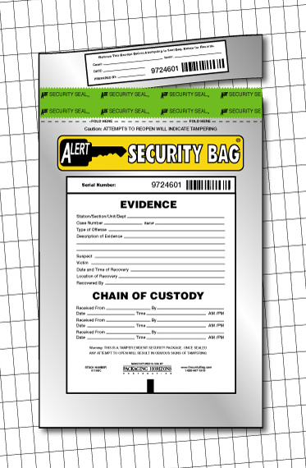
Securing Your Evidence (1 of 2)
Use evidence bags to secure and catalog the evidence
Use computer safe products when collecting computer evidence
Antistatic bags
Antistatic pads
Use well padded containers
Use evidence tape to seal all openings
CD drive bays
Insertion slots for power supply electrical cords and USB cables

Slide 43
Securing Your Evidence (2 of 2)
Write your initials on tape to prove that evidence has not been tampered with
Consider computer specific temperature and humidity ranges
Make sure you have a safe environment for transporting and storing it until a secure evidence container is available

Slide 44
Procedures for Private-Sector High-Tech Investigations: Case study

Slide 45
Procedures for Private-Sector High-Tech Investigations
As an investigator, you need to develop formal procedures and informal checklists
To cover all issues important to high-tech investigations
Ensures that correct techniques are used in an investigation

Slide 46
Employee Termination Cases
The majority of investigative work for termination cases involves employee abuse of corporate assets/resource
Internet abuse investigation
Viewing pornography in the workplace
E-mail abuse investigation
Sending inappropriate e-mails
Organizations must have appropriate policies in place

Slide 47
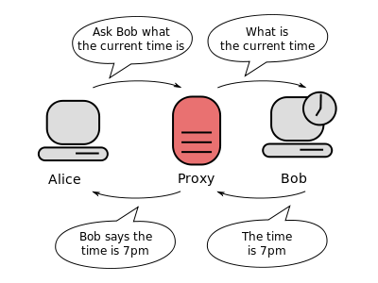
Internet Abuse Investigations (1 of 2)
To conduct an investigation you need:
Organization’s Internet proxy server logs
Suspect computer’s IP address
Suspect computer’s disk drive
Your preferred computer forensics analysis tool

Slide 48
Internet Abuse Investigations (2 of 2)
Recommended steps
Use standard forensic analysis techniques and procedures
Use appropriate tools to extract all Web page URL information
Contact the network firewall administrator and request a proxy server log
Compare the data recovered from forensic analysis to the proxy server log
Continue analyzing the computer’s disk drive data

Slide 49
E-mail Abuse Investigations (1 of 2)
To conduct an investigation you need:
An electronic copy of the offending e-mail that contains message header data
If available, e-mail server log records
For e-mail systems that store users’ messages on a central server, access to the server
Access to the computer so that you can perform a forensic analysis on it
Your preferred computer forensics analysis tool

Slide 50
E-mail Abuse Investigations (2 of 2)
Recommended steps
Use the standard forensic analysis techniques
Obtain an electronic copy of the suspect’s and victim’s e-mail folder or data
For Web-based e-mail investigations, use tools such as FTK’s Internet Keyword Search option to extract all related e-mail address information
Examine header data of all messages of interest to the investigation

Slide 51
Attorney-Client Privilege Investigations (1 of 4)
Under attorney-client privilege (ACP) rules for an attorney
You must keep all findings confidential
Many attorneys like to have printouts of the data you have recovered
You need to persuade and educate many attorneys on how digital evidence can be viewed electronically
You can also encounter problems if you find data in the form of binary files
The rest of 3 slides are optional

Slide 52
Attorney-Client Privilege Investigations (2 of 4)
Steps for conducting an ACP case
Request a memorandum from the attorney directing you to start the investigation
Request a list of keywords of interest to the investigation
Initiate the investigation and analysis
For disk drive examinations, make two bit-stream images using different tools for each image
Compare hash signatures on all files on the original and re-created disks

Slide 53
Attorney-Client Privilege Investigations (3 of 4)
Steps for conducting an ACP case (cont’d)
Methodically examine every portion of the disk drive and extract all data
Run keyword searches on allocated and unallocated disk space
For Windows OSs, use specialty tools to analyze and extract data from the Registry
For binary data files such as CAD drawings, locate the correct software product
For unallocated data recovery, use a tool that removes or replaces nonprintable data

Slide 54
Attorney-Client Privilege Investigations (4 of 4)
Steps for conducting an ACP case (cont’d)
Consolidate all recovered data from the evidence bit-stream image into folders and subfolders
Other guidelines
Minimize written communications with the attorney
Any documentation written to the attorney must contain a header stating that it’s “Privileged Legal Communication—Confidential Work Product”
Assist the attorney and paralegal in analyzing data

Slide 55
Industrial Espionage Investigations (1 of 5)
All suspected industrial espionage cases should be treated as criminal investigations
Staff needed
Digital investigator who is responsible for disk forensic examinations
Technology specialist who is knowledgeable of the suspected compromised technical data
Network specialist who can perform log analysis and set up network sniffers
Threat assessment specialist (typically an attorney)
Rest of 4 slides are optional

Slide 56
Industrial Espionage Investigations (2 of 5)
Guidelines when initiating an investigation
Determine whether this investigation involves a possible industrial espionage incident
Consult with corporate attorneys and upper management
Determine what information is needed to substantiate the allegation
Generate a list of keywords for disk forensics and sniffer monitoring
List and collect resources for the investigation

Slide 57
Industrial Espionage Investigations (3 of 5)
Guidelines (cont’d)
Determine goal and scope of the investigation
Initiate investigation after approval from management
Planning considerations
Examine all e-mail of suspected employees
Search Internet newsgroups or message boards
Initiate physical surveillance
Examine facility physical access logs for sensitive areas

Slide 58
Industrial Espionage Investigations (4 of 5)
Planning considerations (cont’d)
Determine suspect location in relation to the vulnerable asset
Study the suspect’s work habits
Collect all incoming and outgoing phone logs
Steps to conducting an industrial espionage case
Gather all personnel assigned to the investigation and brief them on the plan
Gather resources to conduct the investigation

Slide 59
Industrial Espionage Investigations (5 of 5)
Steps (cont’d)
Place surveillance systems at key locations
Discreetly gather any additional evidence
Collect all log data from networks and e-mail servers
Report regularly to management and corporate attorneys
Review the investigation’s scope with management and corporate attorneys

Slide 60
Understanding Data Recovery Workstations and Software

Slide 61
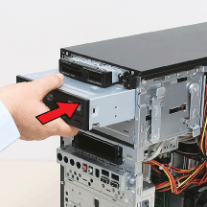
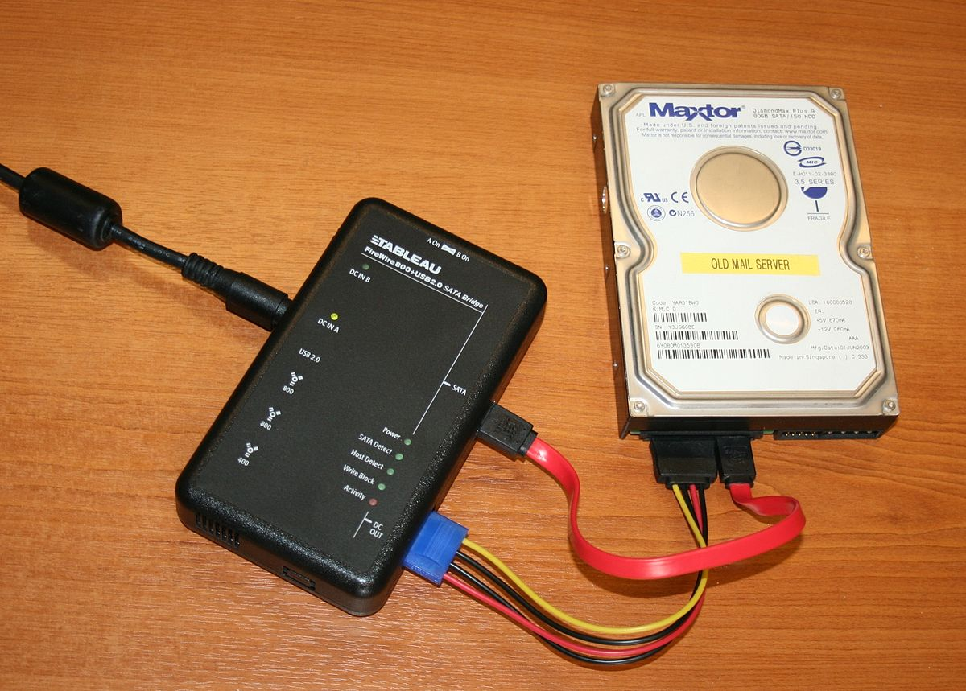
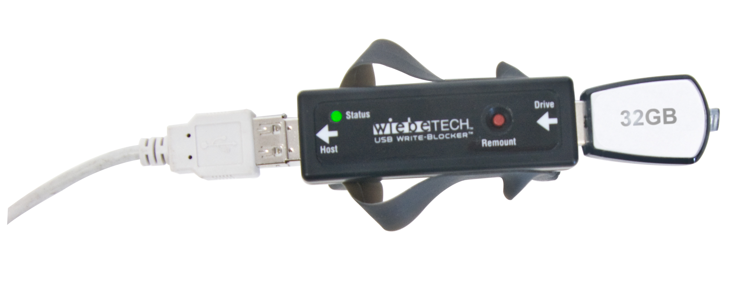
Understanding Data Recovery Workstations and Software
Investigations are conducted on a computer forensics lab (or data-recovery lab)
In data recovery, the customer or your company just wants the data back
Computer forensics workstation
A specially configured PC
Loaded with additional bays and forensics software
To avoid altering the evidence use:
Write-blockers devices
Enable you to boot to Windows without writing data to the evidence drive

Slide 62

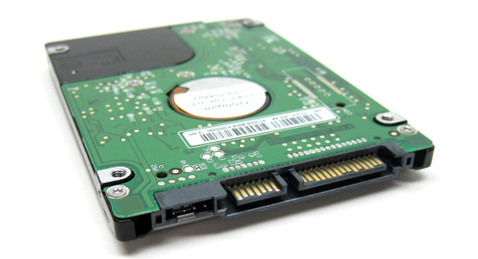
Setting Up Your Workstation for Digital Forensics (1 of 2)
Basic requirements
A workstation running Windows 7 or later
A write-blocker device
Digital forensics acquisition tool
Digital forensics analysis tool
Target drive to receive the source or suspect disk data
SATA ports
USB ports

Slide 63
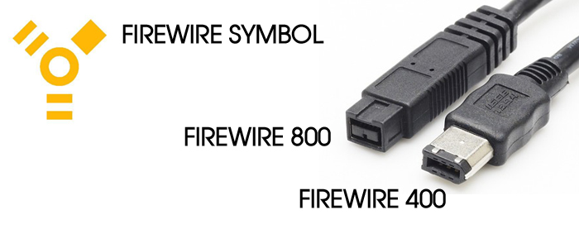
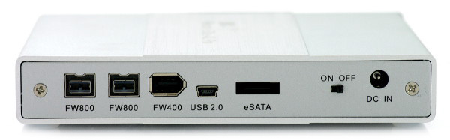
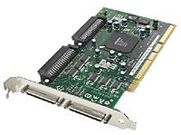
Setting Up your Workstation for Digital Forensics (2 of 2)
Additional useful items
Network interface card (NIC)
Extra USB ports
FireWire 400/800 ports
SCSI card
Disk editor tool
Text editor tool
Graphics viewer program
Other specialized viewing tools

Slide 64
Conducting an Investigation

Slide 65
Conducting an Investigation
Items needed to retrieving data
Original storage media
Evidence custody form
Forensic workstation to copy and examine your evidence
Bit-stream imaging tool
Evidence container for the storage media
Securable evidence locker, cabinet, or safe

Slide 66
Gathering the Evidence
Steps
Meet the IT manager to interview him
Fill out the evidence form, have the IT manager sign
Place the evidence in a secure container
Carry the evidence to the computer forensics lab
Complete the evidence custody form
Secure evidence by locking the container
Note: Avoid damaging the evidence

Slide 67
Understanding Bit-Stream Copies (1 of 2)
Bit-stream copy
Bit-by-bit copy of the original storage medium
Exact copy of the original disk
Different from a simple backup copy
Backup software only copy known files
Backup software cannot copy deleted files, e-mail messages or recover file fragments
Bit-stream image
File containing the bit-stream copy of all data on a disk or partition
Also known as “image” or “image file”
Copy image file to a target disk that matches the original disk’s manufacturer, size and model

Slide 68
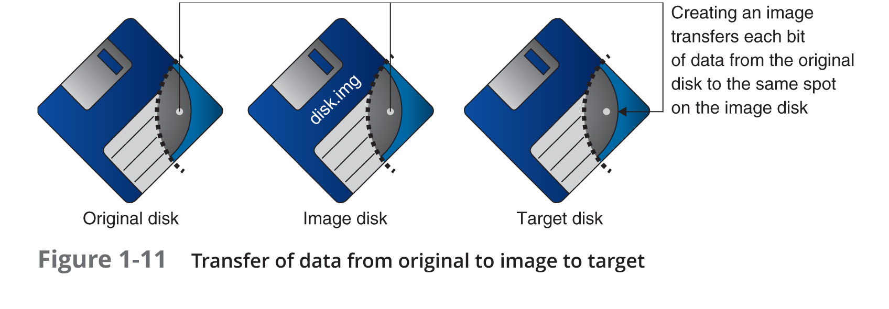
Understanding Bit-stream Copies (2 of 2)

Slide 69
Acquiring an Image of Evidence Media
First rule of computer forensics
Preserve the original evidence
Conduct your analysis only on a copy of the data
Several vendors provide MS-DOS, Linux, and Windows acquisition tools
Windows tools require a write-blocking device when acquiring data from FAT or NTFS file systems

Slide 70
Analyzing Your Digital Evidence (1 of 8)
Your job is to recover data from:
Deleted files
File fragments
Deleted files linger on the disk until new data is saved on the same physical location
Tools can be used to retrieve deleted files
Autopsy

Slide 71
Analyzing Your Digital Evidence (2 of 8)
Steps to analyze a USB drive
Start Autopsy
Create a new case
Type the case name
Select the working folder
Steps to add source data
Select data source type
Select image file
Keep the default settings in the Configure Ingest Modules window

Slide 72
Analyzing Your Digital Evidence (3 of 8)
Steps to display the contents of the acquired data
Click to expand Views, File Types, By Extension, and Documents
Select file to display
Click Tag and Comment
Click the New Tag Name button
Analyze the data
Search for information related to the complaint
Data analysis can be most time-consuming task

Slide 73
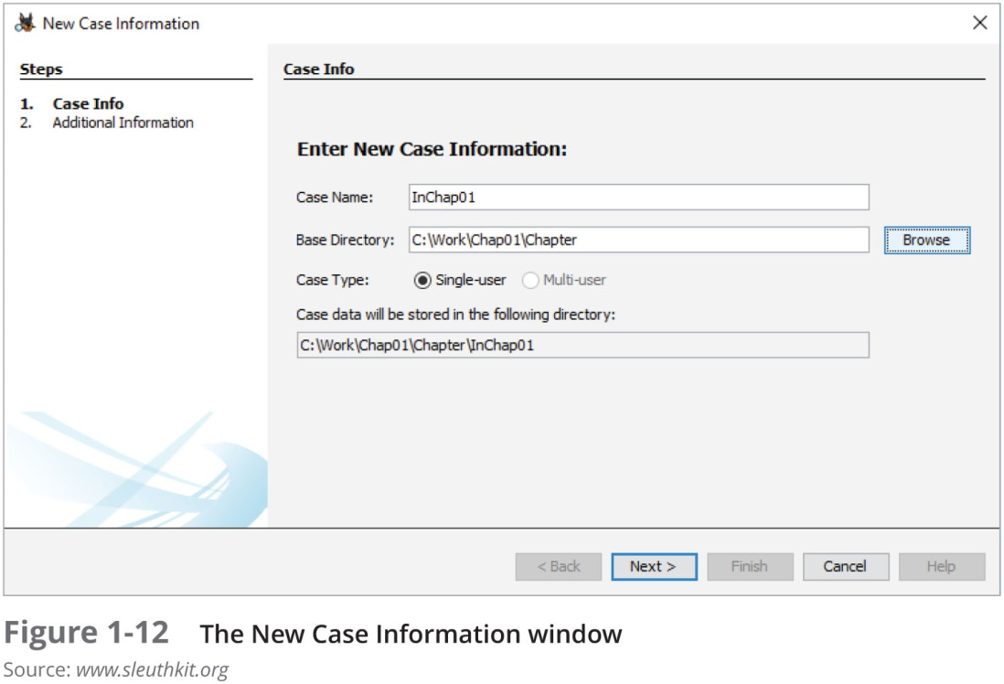
Analyzing Your Digital Evidence (4 of 8)

Slide 74
Analyzing Your Digital Evidence (5 of 8)
With Autopsy you can:
Search for keywords of interest in the case
Display the results in a search results window
Click each file in the search results window and examine its content in the data area
Export the data to a folder of your choice
Search for specific filenames
Generate a report of your activities
Additional features of Autopsy
Display binary (nonprintable) data in the Content Viewer

Slide 75
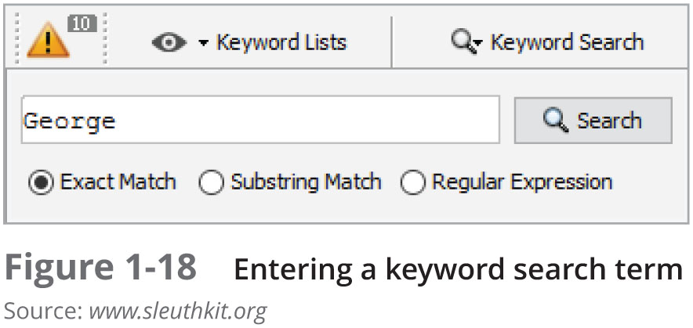
Analyzing Your Digital Evidence (6 of 8)

Slide 76
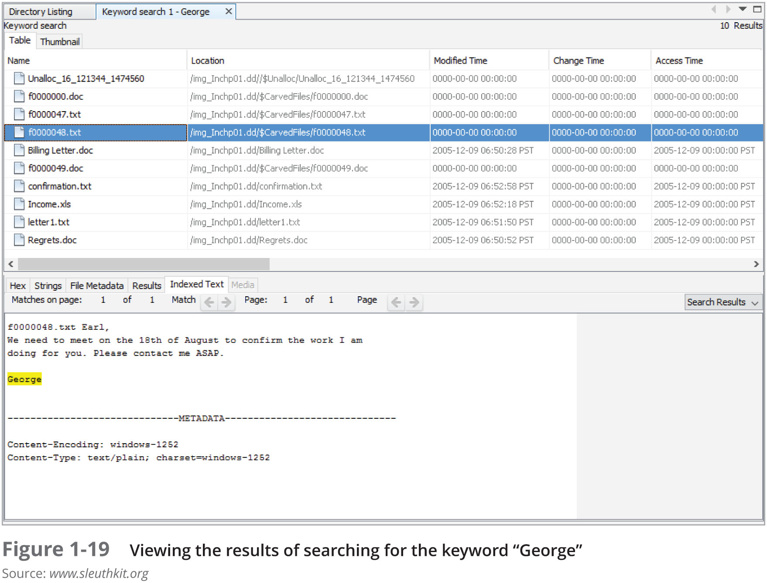
Analyzing Your Digital Evidence (7 of 8)

Slide 77
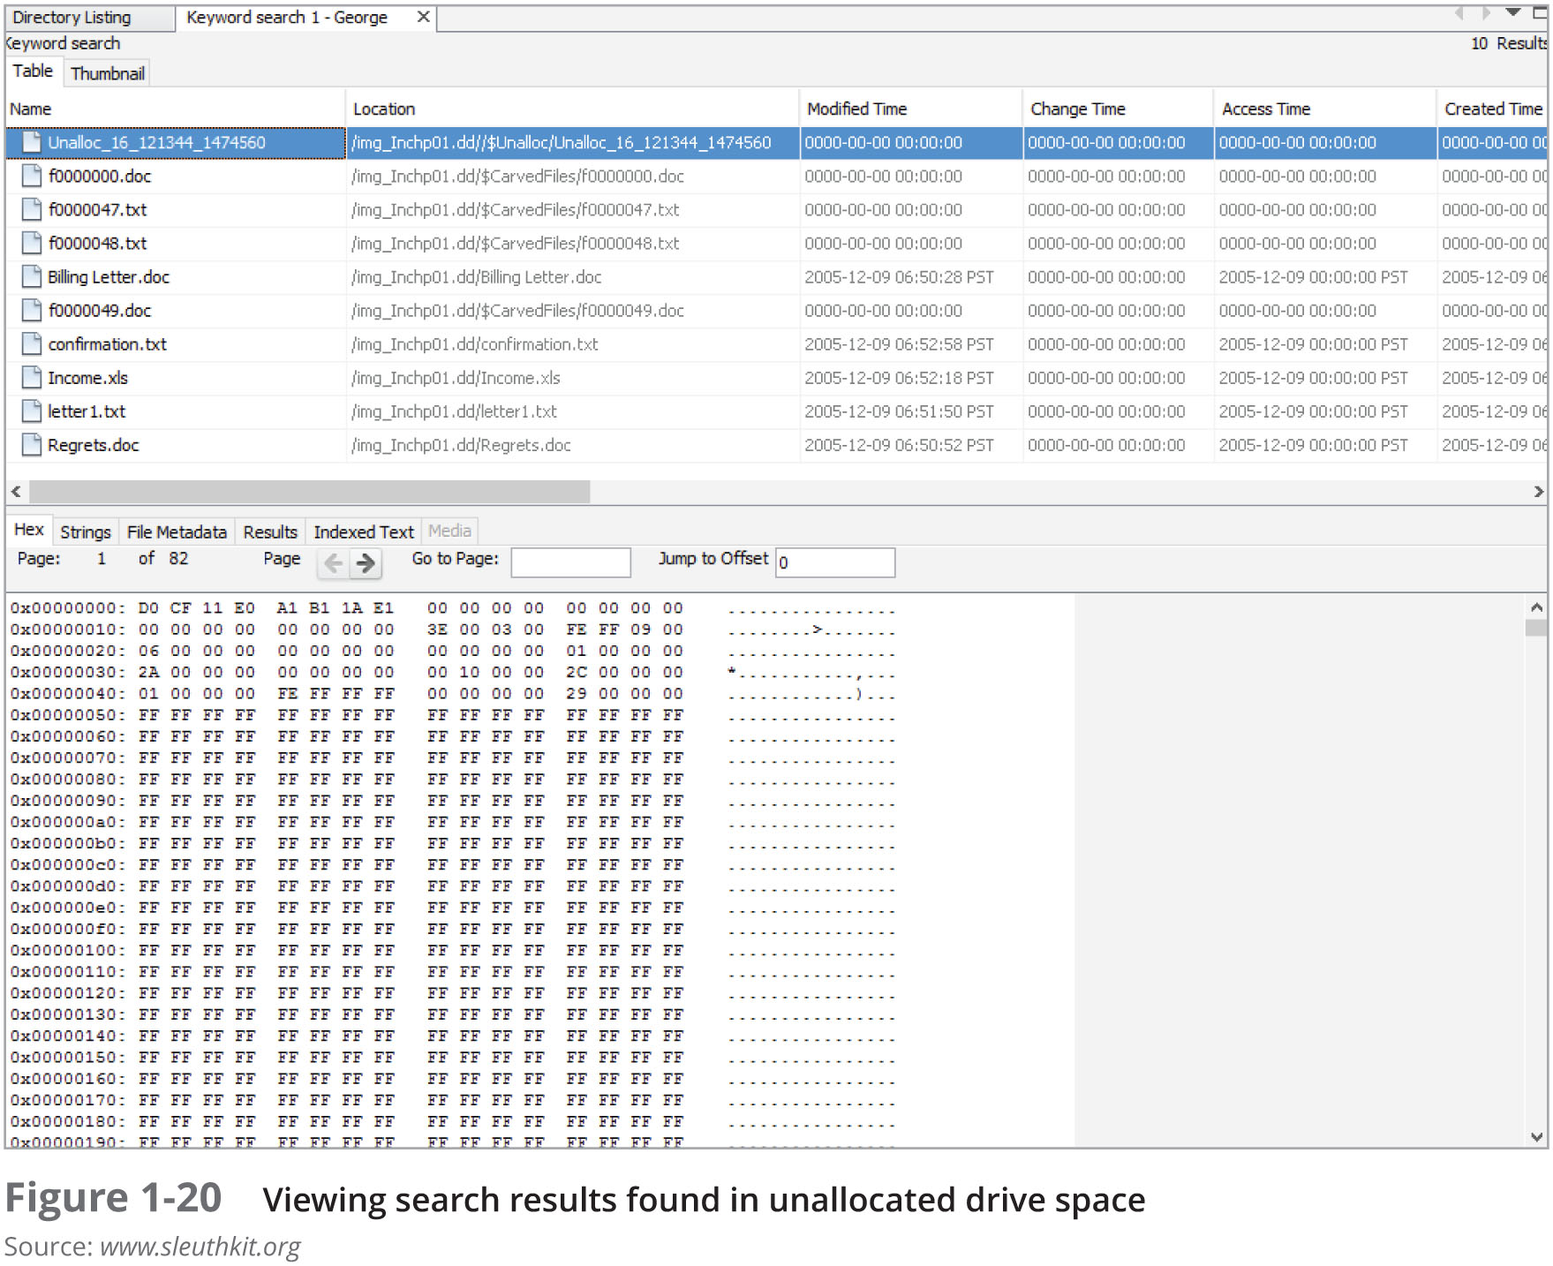
Analyzing Your Digital Evidence (8 of 8)

Slide 78
Completing the Case (1 of 2)
You need to produce a final report
State what you did and what you found
Include Autopsy report to document your work
Repeatable findings
Repeat the steps and produce the same result
If required, use a report template
Report should show conclusive evidence
Suspect did or did not commit a crime or violate a company policy

Slide 79
Completing the Case (2 of 2)
Keep a written journal of everything you do
Your notes can be used in court
Answer the six Ws:
Who, what, when, where, why, and how
You must also explain computer and network processes
Autopsy Report Generator
Can generate reports in different styles: plain text, HTML and Excel

Slide 80
Critiquing the Case
Ask yourself the following questions:
How could you improve your performance in the case?
Did you expect the results you found? Did the case develop in ways you did not expect?
Was the documentation as thorough as it could have been?
What feedback has been received from the requesting source?
Did you discover any new problems? If so, what are they?
Did you use new techniques during the case or during research?

Slide 81
Summary (1 of 3)
Digital forensics involves systematically accumulating and analyzing digital information for use as evidence in civil, criminal, and administrative cases
Investigators need specialized workstations to examine digital evidence
Public-sector and private-sector investigations differ; public-sector typically require search warrants before seizing digital evidence

Slide 82
Summary (2 of 3)
Always use a systematic approach to your investigations
Always plan a case taking into account the nature of the case, case requirements, and gathering evidence techniques
Both criminal cases and corporate-policy violations can go to court
Plan for contingencies for any problems you might encounter
Keep track of the chain of custody of your evidence

Slide 83
Summary (3 of 3)
Internet abuse investigations require examining server log data
For attorney-client privilege cases, all written communication should remain confidential
A bit-stream copy is a bit-by-bit duplicate of the original disk
Always maintain a journal to keep notes on exactly what you did
You should always critique your own work

